Slide 1


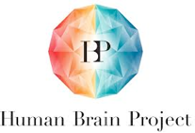



Neural networks: an introduction
Christopher Summerfield
University of Oxford
funding
Notes:
I’m going to talk about some recent published work, and then go off piste and talk about some unpublished work about control in navigation.

Slide 2

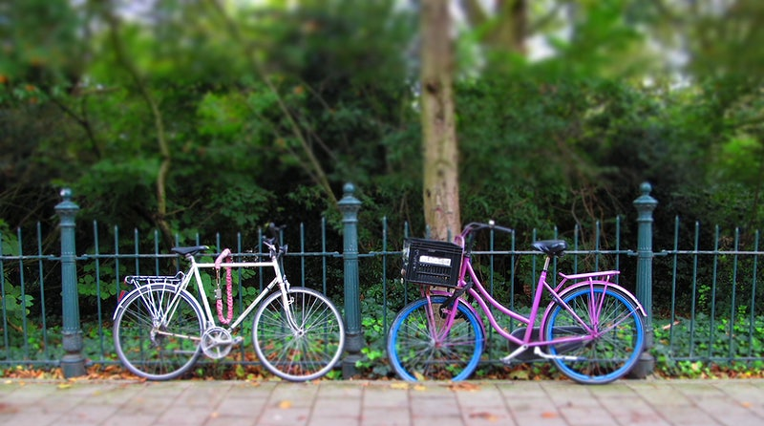

The goals of perception
tree
Abstracting over similarities (invariant recognition)
Inferring names and properties (semantic cognition)
Computing affordances (sensorimotor behaviour)
Notes:
In my talk I’m going to describe a systematic investigation of human transfer. I’m going to show that people can exhibit quite striking zeros-shot compositional generalization.
I use the term nontrivial to describe this generalization. By that I mean that it cannot be chalked up to a demand characteristic of the task and that neural networks do not show this generalization.
I’m going to describe two different manipulations of the training curriculum that encourage or discourage generalization.
I’m going to show that a simple computational idea can be incorporated into a neural network to make them transfer like humans in the experimental setting we study
And finally, I’m going to show you something else interesting that humans do.

Slide 3
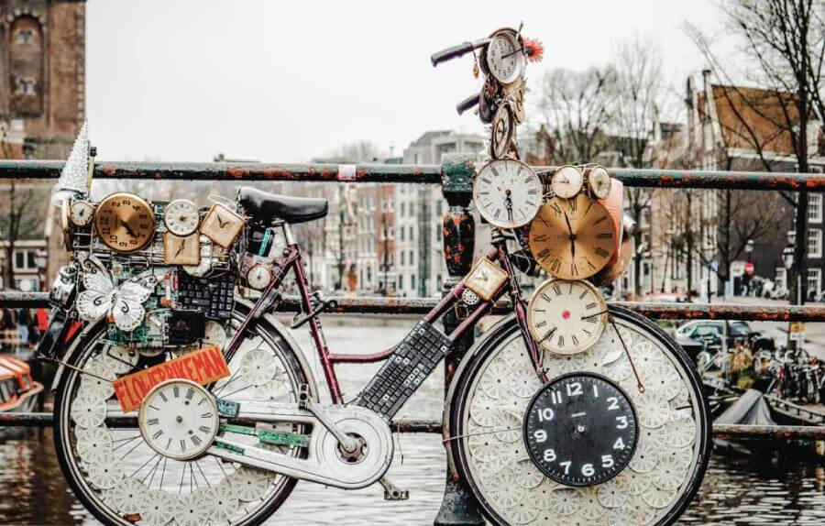

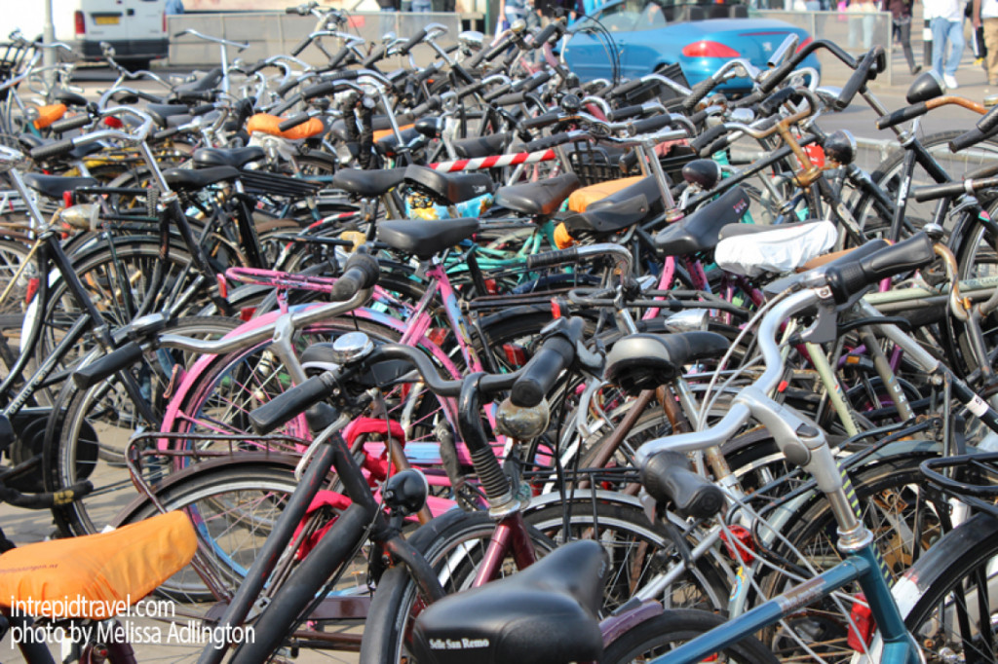
Perception is hard
ambiguous information
unusual views
cluttered scenes
Notes:
In my talk I’m going to describe a systematic investigation of human transfer. I’m going to show that people can exhibit quite striking zeros-shot compositional generalization.
I use the term nontrivial to describe this generalization. By that I mean that it cannot be chalked up to a demand characteristic of the task and that neural networks do not show this generalization.
I’m going to describe two different manipulations of the training curriculum that encourage or discourage generalization.
I’m going to show that a simple computational idea can be incorporated into a neural network to make them transfer like humans in the experimental setting we study
And finally, I’m going to show you something else interesting that humans do.

Slide 4

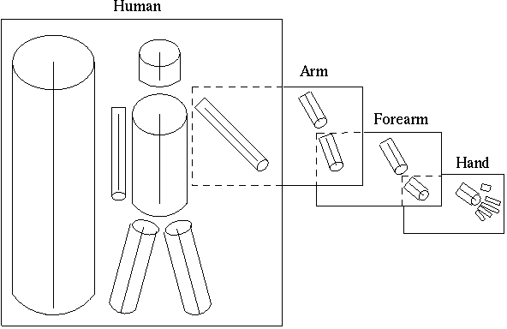
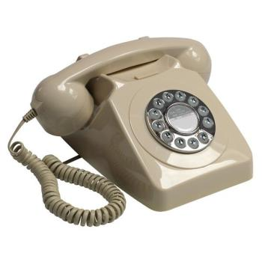
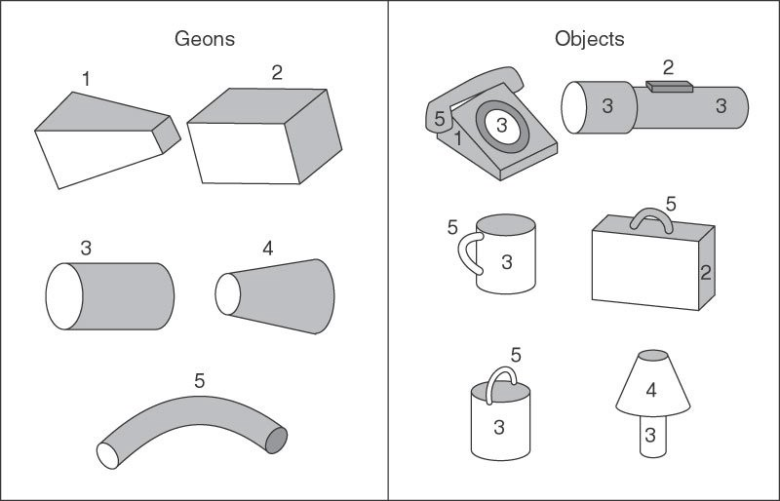

Hand crafted models
Marr & Nishihara, 1978
Biederman, 1987
What is the nature of the internal state?
Early theories proposed that (viewer-centred) 2d images were converted to (object-centred) 3d representations via hand-coded volumetric primitives
Notes:
Let’s begin with a question. What is really special about human intelligence? What makes us distinctive from that of other highly intelligent species, such as monkeys and birds?
Well, there are lots of anwers to this question, but in this talk I’d like to focus on one of them.

Slide 5
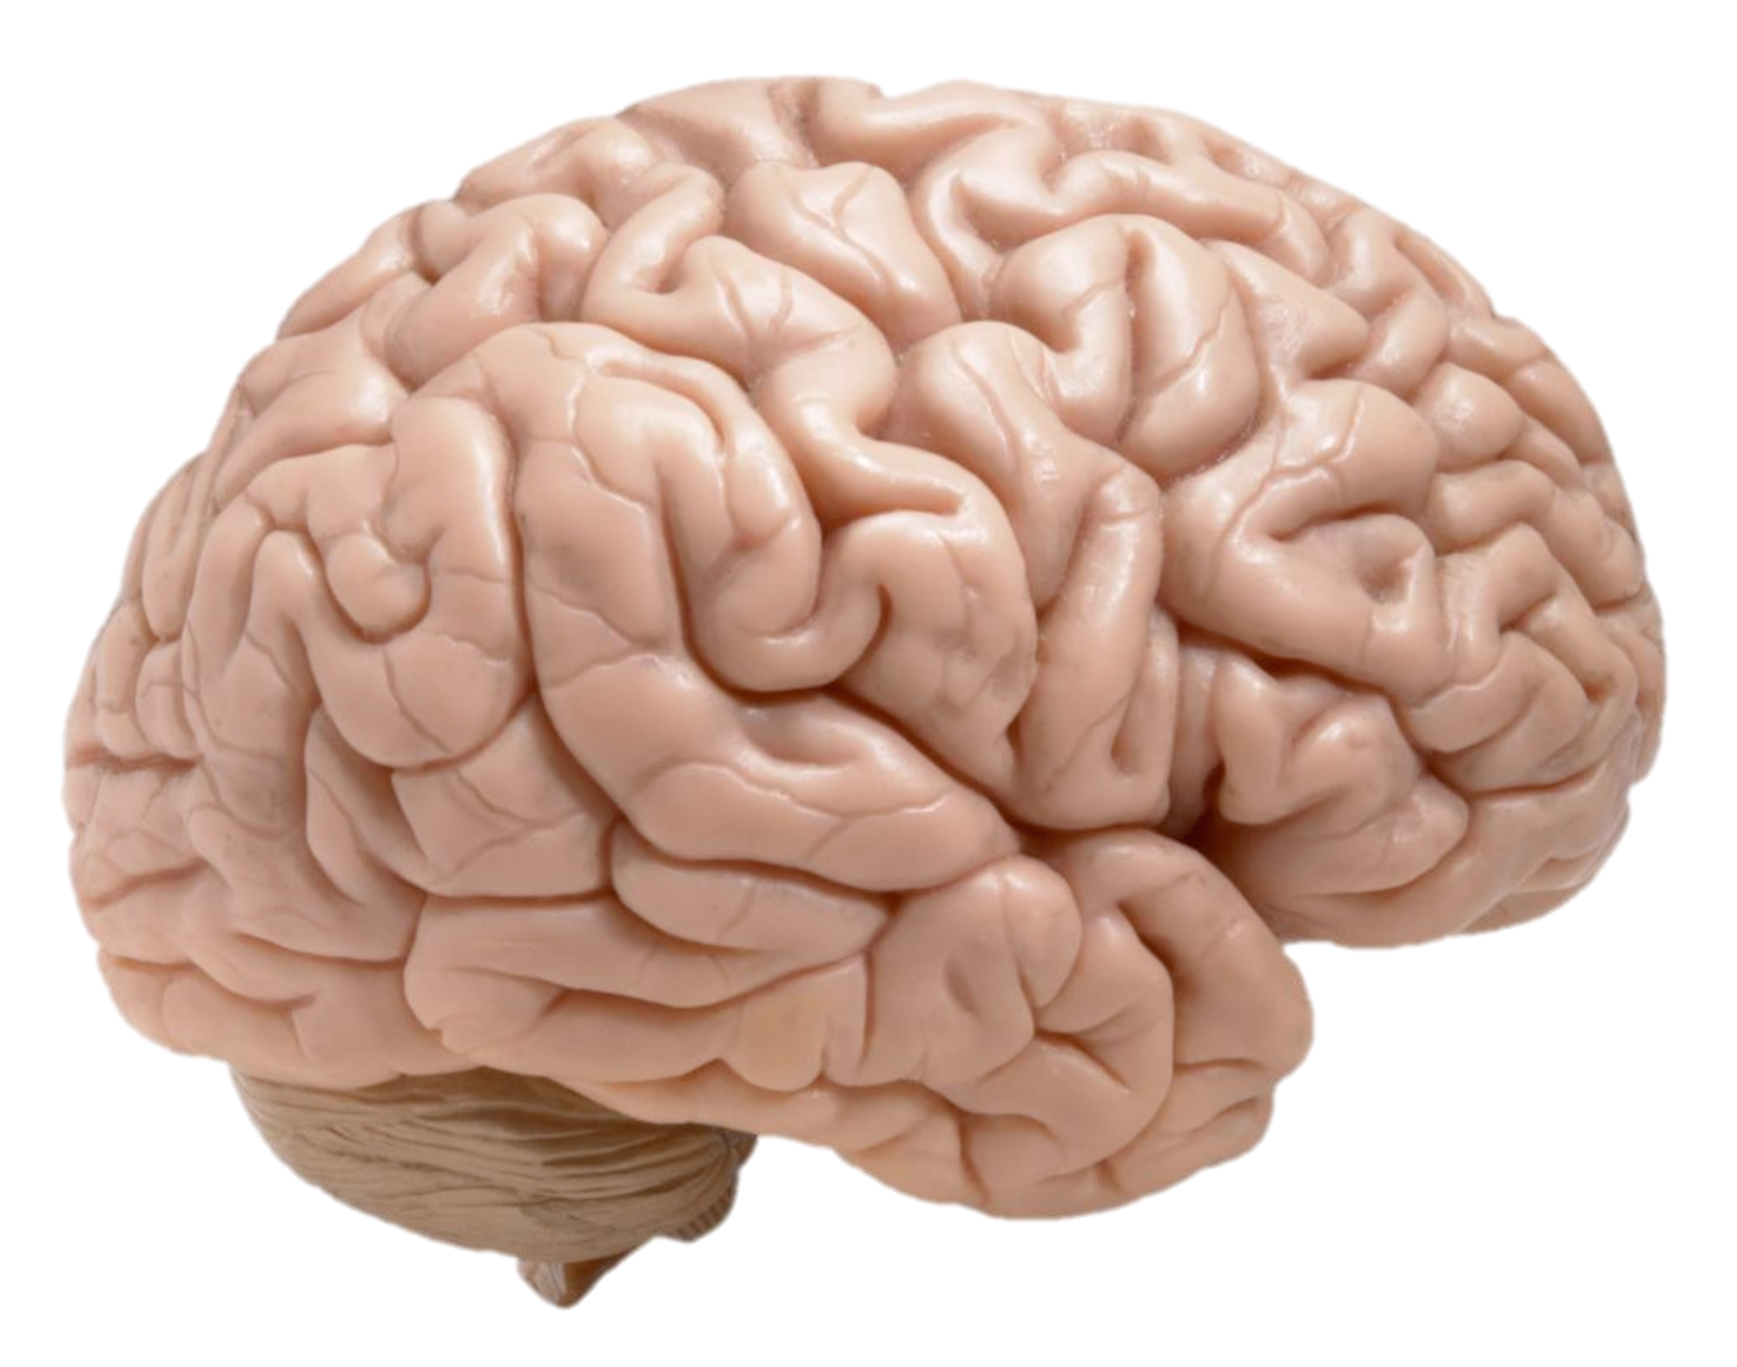
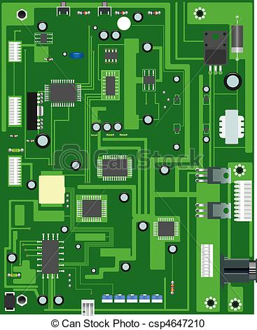
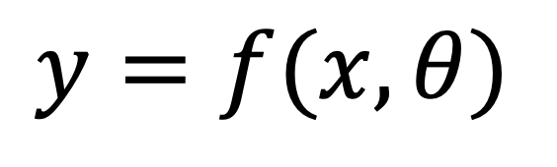
The computational approach
real
simulated
parameters
function
$$y=f(x,θ)$$
output
input
Mathematics provides a compact and precise language for describing input-output relations
Computational models are just parameterized functions (or programs, expressed in computer code) that transform inputs into outputs
Notes:
In my talk I’m going to describe a systematic investigation of human transfer. I’m going to show that people can exhibit quite striking zeros-shot compositional generalization.
I use the term nontrivial to describe this generalization. By that I mean that it cannot be chalked up to a demand characteristic of the task and that neural networks do not show this generalization.
I’m going to describe two different manipulations of the training curriculum that encourage or discourage generalization.
I’m going to show that a simple computational idea can be incorporated into a neural network to make them transfer like humans in the experimental setting we study
And finally, I’m going to show you something else interesting that humans do.

Slide 6
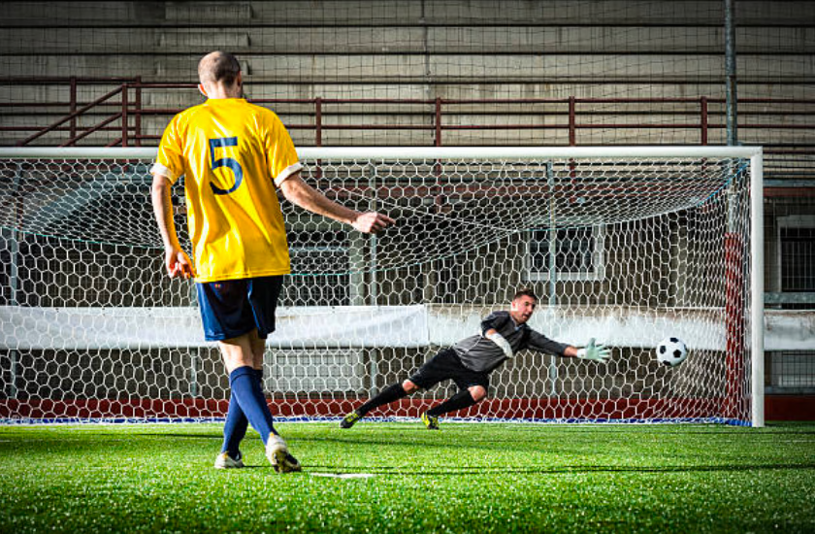
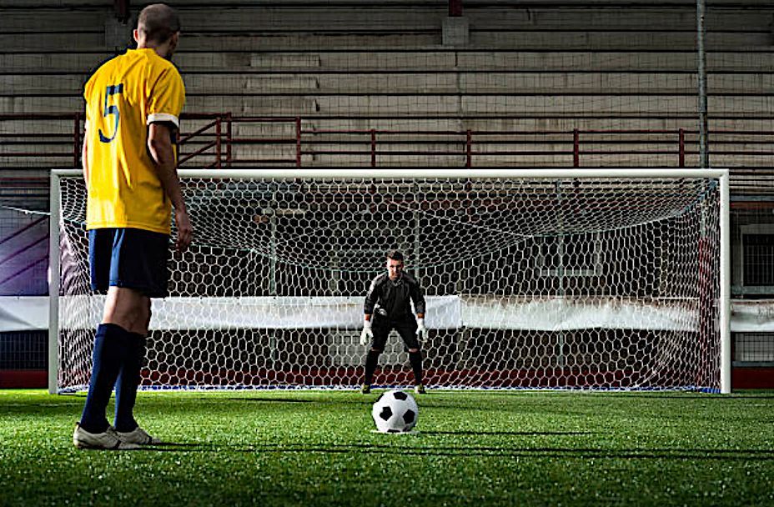
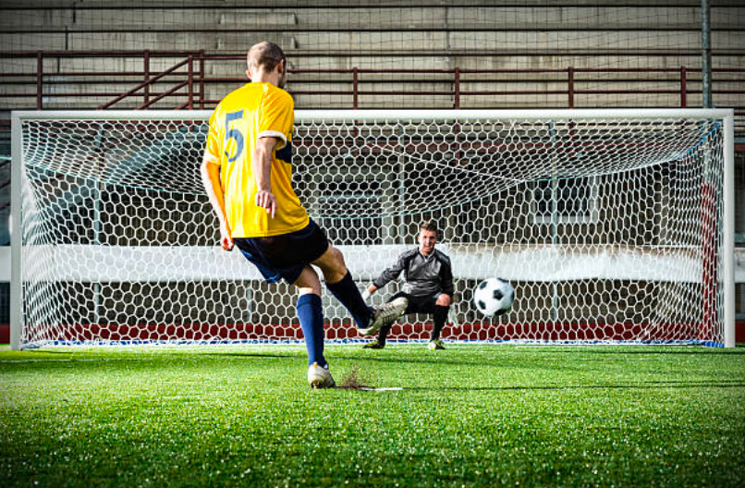
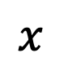
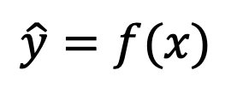
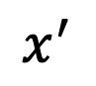
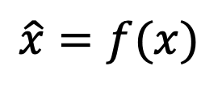
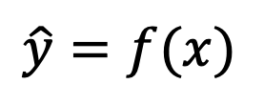
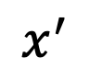
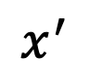
Mapping functions
$$x^{′}$$
$$\hat{y}=f(x)$$
$$x$$
$$x^{′}$$
$$x^{′}$$
A football player is about to take a penalty. He is wearing a yellow shirt.
$$\hat{x}=f(x)$$
$$\hat{y}=f(x)$$
Notes:
Let’s begin with a question. What is really special about human intelligence? What makes us distinctive from that of other highly intelligent species, such as monkeys and birds?
Well, there are lots of anwers to this question, but in this talk I’d like to focus on one of them.

Slide 7
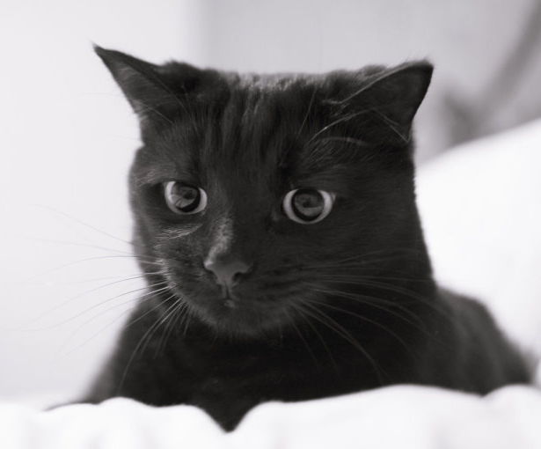
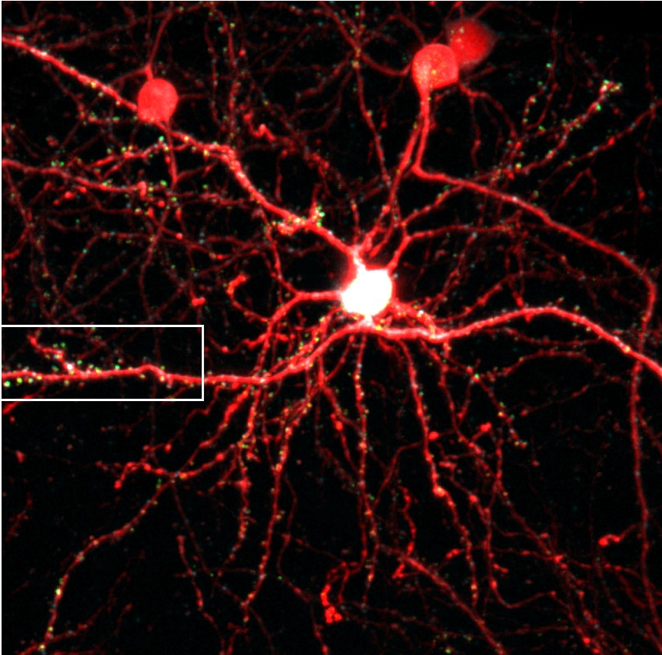
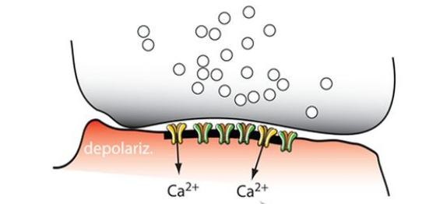
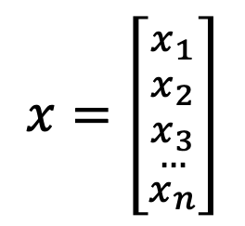
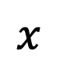
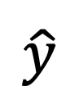
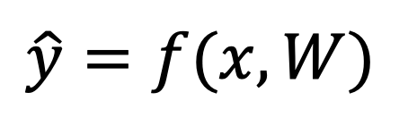
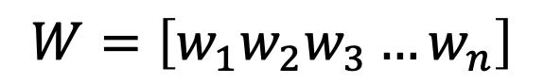
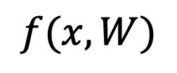
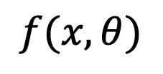
Encoding models
$$\hat{y}=f(x,W)$$
$$x$$
$$f(x,θ)$$
$$\hat{y}$$
$$f(x,W)$$
“cat”
$$x=\left[{{x_{1} \atop x_{2}} \atop {\begin{aligned}x_{3} \\ …\end{aligned} \atop x_{n}}}\right]$$
parameters
$$W=\left[w_{1}w_{2}w_{3}…w_{n}\right]$$
Notes:
Let’s begin with a question. What is really special about human intelligence? What makes us distinctive from that of other highly intelligent species, such as monkeys and birds?
Well, there are lots of anwers to this question, but in this talk I’d like to focus on one of them.

Slide 8
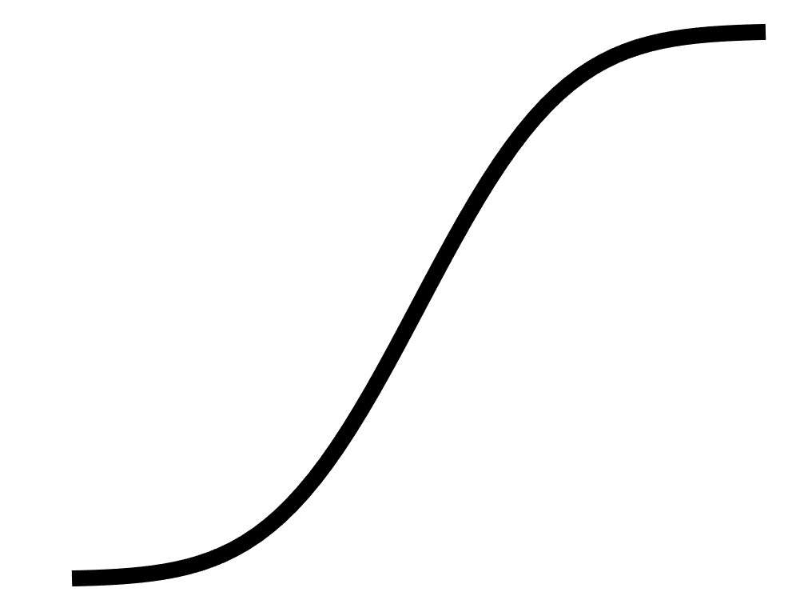
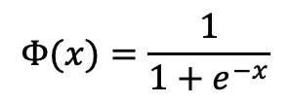
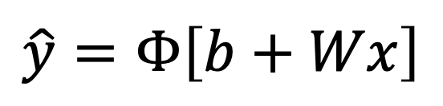
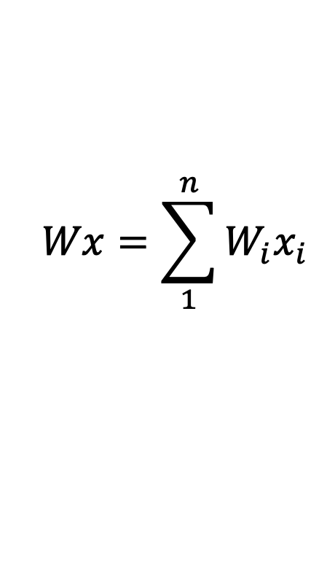
Encoding models
$$\hat{y}=f(x,W)$$
$$Φ(x)=\frac{1}{1+e^{−x}}$$
$$Wx=\sum_{1}^{n}{W_{i}x_{i}}$$
sigmoid
$$x$$
$$f(x,θ)$$
$$\hat{y}=Φ\left[b+Wx\right]$$
$$f(x,W)$$
“cat”
$$x=\left[{{x_{1} \atop x_{2}} \atop {\begin{aligned}x_{3} \\ …\end{aligned} \atop x_{n}}}\right]$$
parameters
$$W=\left[w_{1}w_{2}w_{3}…w_{n}\right]$$
Notes:
Let’s begin with a question. What is really special about human intelligence? What makes us distinctive from that of other highly intelligent species, such as monkeys and birds?
Well, there are lots of anwers to this question, but in this talk I’d like to focus on one of them.

Slide 9
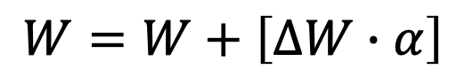
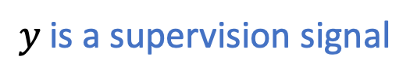
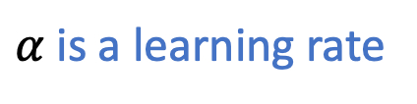
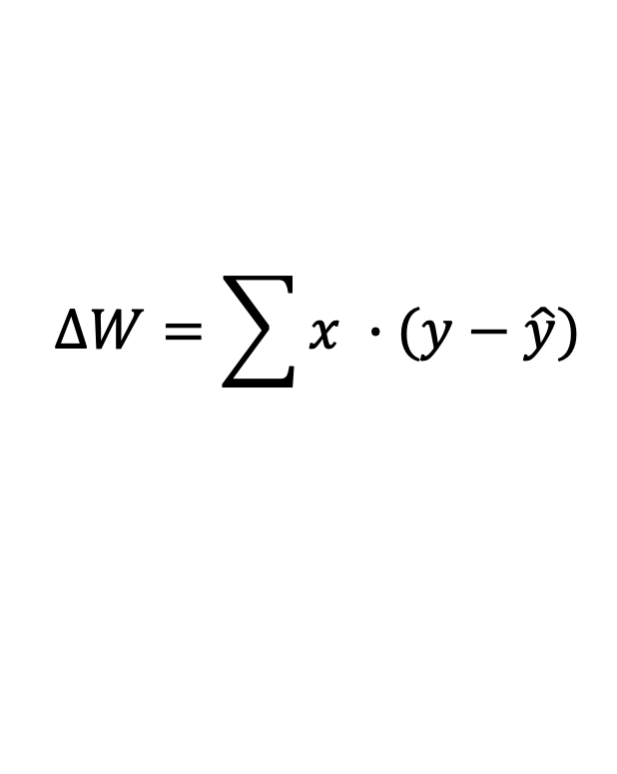
Encoding models
$$\hat{y}=f(x,W)$$
$$Φ(x)=\frac{1}{1+e^{−x}}$$
$$Wx=\sum_{1}^{n}{W_{i}x_{i}}$$
sigmoid
$$x$$
$$f(x,θ)$$
$$\hat{y}=Φ\left[b+Wx\right]$$
$$f(x,W)$$
“cat”
weight update:
$$x=\left[{{x_{1} \atop x_{2}} \atop {\begin{aligned}x_{3} \\ …\end{aligned} \atop x_{n}}}\right]$$
parameters
$$W=W+\left[∆W∙α\right]$$
$$∆W=\sum{x ∙(y−\hat{y})}$$
$$W=\left[w_{1}w_{2}w_{3}…w_{n}\right]$$
$α$ is a learning rate
$$y \text{is} \text{a} \text{supervision} \text{signal}$$
Notes:
Let’s begin with a question. What is really special about human intelligence? What makes us distinctive from that of other highly intelligent species, such as monkeys and birds?
Well, there are lots of anwers to this question, but in this talk I’d like to focus on one of them.

Slide 10

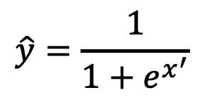
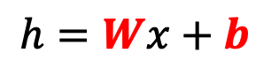
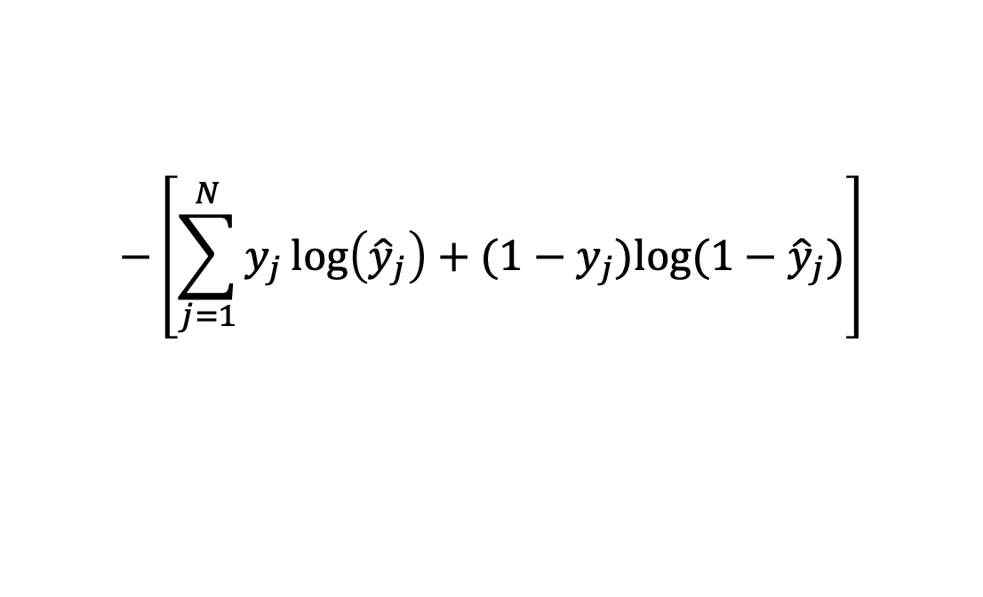
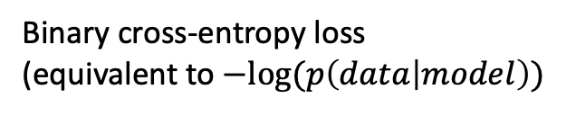
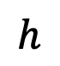
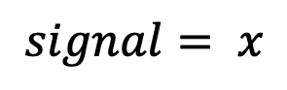
Model fitting: the basics
$$\hat{y}=\frac{1}{1+e^{x^{′}}}$$
$$h$$
Loss function:
$$−\left[\sum_{j=1}^{N}{y_{j}\log\left({\hat{y}}_{j}\right)+(1−y_{j}})log⁡(1−{\hat{y}}_{j})\right]$$
$$h=Wx+b$$
$$signal= x$$
Binary cross-entropy loss
(equivalent to $−log⁡(p\left(data | model\right))$

Slide 11
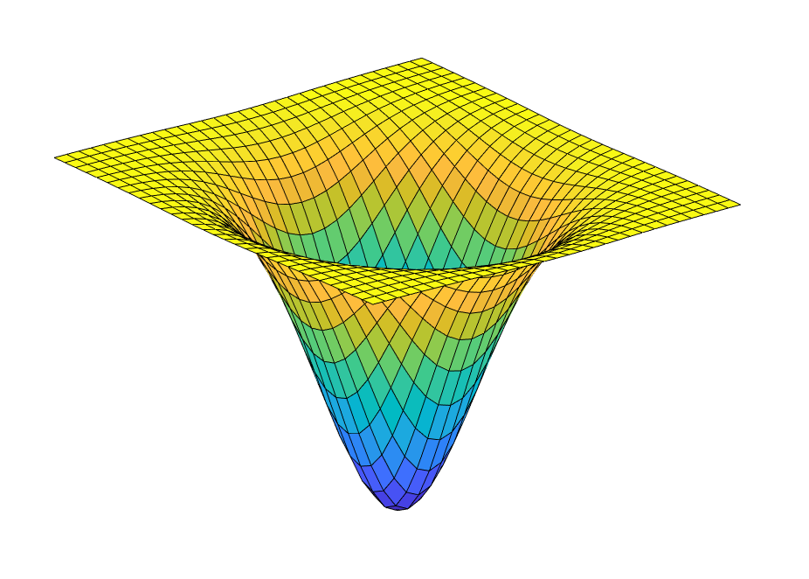
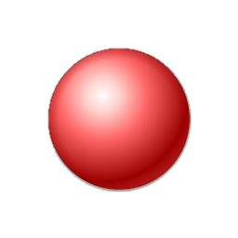
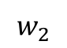
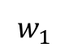
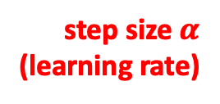
Gradient descent
Network weights are typically trained with gradient descent
visualisation with 2 weights
This involves calculating the derivative of the loss with respect to the parameters, i.e., how much better does a prediction get for a given change in weights?
For linear problems, the error landscape is convex, i.e., there is a single global minimum
$$w_{1}$$
$$w_{2}$$
step size $α$
(learning rate)
Loss
(how bad
is your prediction)
global minimum
(best prediction)
Notes:
Let’s begin with a question. What is really special about human intelligence? What makes us distinctive from that of other highly intelligent species, such as monkeys and birds?
Well, there are lots of anwers to this question, but in this talk I’d like to focus on one of them.

Slide 12
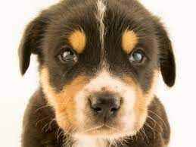












Generalisation
$$x_{train}$$
$$y_{train}$$
$$y=f(x,θ)$$
“cat”
“dog”
$$p(cat)$$
“cat”
$$f(x,θ)$$
$$t (teaching)$$
$$x_{test}$$
$$y_{test}$$
“dog”
$$p(cat)$$
“dog”
Notes:
Let’s begin with a question. What is really special about human intelligence? What makes us distinctive from that of other highly intelligent species, such as monkeys and birds?
Well, there are lots of anwers to this question, but in this talk I’d like to focus on one of them.

Slide 13

Object recognition
every experience unique
no two views of the same object are exactly alike
so the brain needs to compute invariances
Notes:
Let’s begin with a question. What is really special about human intelligence? What makes us distinctive from that of other highly intelligent species, such as monkeys and birds?
Well, there are lots of anwers to this question, but in this talk I’d like to focus on one of them.

Slide 14

Over and underfitting
This model is underfit (high bias). It can’t capture the training or test data.
This model fits just right. It has some training error, but fits test well
This model is overfit (high variance). It captures the training data perfectly, but fails at test
Simple example of overfitting with ground truth $y=x^{2}+𝒩(0,σ)$
Notes:
Let’s begin with a question. What is really special about human intelligence? What makes us distinctive from that of other highly intelligent species, such as monkeys and birds?
Well, there are lots of anwers to this question, but in this talk I’d like to focus on one of them.

Slide 15




Generalisation
cat (test)
effective boundary
dog (test)
Network achieves 100% correct performance
cat (train)
training loss
dog (train)
ear pointiness
timestep
animal size
Imagine you train a network on this training set, and it converges to loss ~0
Now you test on this left out set, but it is at chance! Why….?
The network has learned to classify according to a single variable: number of black pixels.
It hasn’t learned anything about cats and dogs at all!
Notes:
Let’s begin with a question. What is really special about human intelligence? What makes us distinctive from that of other highly intelligent species, such as monkeys and birds?
Well, there are lots of anwers to this question, but in this talk I’d like to focus on one of them.

Slide 16

Double descent
Notes:
Let’s begin with a question. What is really special about human intelligence? What makes us distinctive from that of other highly intelligent species, such as monkeys and birds?
Well, there are lots of anwers to this question, but in this talk I’d like to focus on one of them.

Slide 17






Nonlinearities
$$y=W^{R}h$$
$$W^{R}$$
$$h=Wx$$
$$W$$
$$x$$
deep linear network
Notes:
Let’s begin with a question. What is really special about human intelligence? What makes us distinctive from that of other highly intelligent species, such as monkeys and birds?
Well, there are lots of anwers to this question, but in this talk I’d like to focus on one of them.

Slide 18































A simple example
$$loss={(y−\hat{y})}^{2}$$
$$y=1$$
$$x=\left[1 0 0 0\right]$$
$$y=hW^{R}$$
$$y$$
$$[−1,2]$$
9
$$y=2$$
$$x=\left[0 1 0 0\right]$$
-1
2
$$h_{1}$$
$$y=3$$
$$x= \left[0 0 1 0\right]$$
$$h=xW$$
$$h_{1}$$
$$h_{2}$$
9
$$y=4$$
$$x= \left[0 0 0 1\right]$$
5
2
2
$$h_{2}$$
$$b$$
$$x_{1}$$
$$x_{2}$$
$$x_{3}$$
$$x_{4}$$
$$h=$$
$[1 0 0 0]$ $×$
$$[9 2$$
$8 3$
$7 4$
$6 5]$

Slide 19






Nonlinearities and the XOR problem
$x^{A}$ =$\left[\begin{aligned}1,−1 \\ 1, −1\end{aligned}\right]$
$x^{B}$ =$\left[\begin{aligned}−1 1 \\ 1,−1\end{aligned}\right]$
Single-layer networks can solve linear but not nonlinear classification tasks
Rows are different features (e.g., $x_{1}$) and columns are different exemplars
This simple problem halted progress in AI research for ~20 years, leading to the first “AI winter”.
B
+1
A
$$x_{2}$$
$$x_{1}$$
-1
+1
You can’t draw a single straight line that separates A from B!
A
-1
B
Notes:
Let’s begin with a question. What is really special about human intelligence? What makes us distinctive from that of other highly intelligent species, such as monkeys and birds?
Well, there are lots of anwers to this question, but in this talk I’d like to focus on one of them.

Slide 20






Nonlinearities
$$y=W^{R}h$$
$$y=W^{R}h$$
$$W^{R}$$
$$W^{R}$$
ReLU
$$h=Wx$$
$$h=g(Wx)$$
$$g\left(x\right)=\left\{\begin{aligned}0,x<0 \\ &x, x≥0\end{aligned}\right.$$
$$W$$
$$W$$
$$x$$
$$x$$
deep linear network
deep nonlinear network
Notes:
Let’s begin with a question. What is really special about human intelligence? What makes us distinctive from that of other highly intelligent species, such as monkeys and birds?
Well, there are lots of anwers to this question, but in this talk I’d like to focus on one of them.

Slide 21




Nonlinearities
$$y=W^{R}h$$
B
+1
A
$$x_{2}$$
ReLU acts as a gate
$$x_{1}$$
-1
+1
$$W$$
A
B
-1
$$x$$
The nonlinearity allows the network to solve the problem by gating information into two independent subspaces
Notes:
Let’s begin with a question. What is really special about human intelligence? What makes us distinctive from that of other highly intelligent species, such as monkeys and birds?
Well, there are lots of anwers to this question, but in this talk I’d like to focus on one of them.

Slide 22



Neural network model
B
A
exponential trajectory
unstructured RDM
high norm
low sparsity
task agnostic
lazy learning
unstructured solution
A
B
low weight variance: rich regime
B
A
sigmoidal trajectory
structured RDM
low norm
high sparsity
task specific
high weight variance: lazy regime
rich learning
structured solution
A
B
See Jacot et al 2018; Chizat et al 2019

Slide 23

The visual hierarchy
During the forward sweep of visual processing (~100ms), a signal of dimensionality ~37M in V1 is compressed into a signal of d(~10M)
Notes:
Let’s begin with a question. What is really special about human intelligence? What makes us distinctive from that of other highly intelligent species, such as monkeys and birds?
Well, there are lots of anwers to this question, but in this talk I’d like to focus on one of them.

Slide 24








Hierarchical filtering
decoder
$$y=g(x′′′,θ′′′)$$
$$x^{′}$$
$$x^{′′}$$
$$x^{′′′}$$
cat neuron
$$x′=f(x,θ)$$
$$x′′=f′(x′,θ′)$$
$$x′′′=f′′(x′′,θ′′)$$
$$x$$
$$y$$
encoder
dog neuron
Notes:
Let’s begin with a question. What is really special about human intelligence? What makes us distinctive from that of other highly intelligent species, such as monkeys and birds?
Well, there are lots of anwers to this question, but in this talk I’d like to focus on one of them.

Slide 25






Convolutional neural networks
$$b_{i}=\frac{a_{i}}{{\left(k+α∙\sum{a_{j}^{2}}\right)}^{β}}$$
divisive normalisation
dimensionality reduction
layerwise depth
convolution
local receptivity
Krizhevsky et al 2012
Notes:
Let’s begin with a question. What is really special about human intelligence? What makes us distinctive from that of other highly intelligent species, such as monkeys and birds?
Well, there are lots of anwers to this question, but in this talk I’d like to focus on one of them.

Slide 26




Imagenet
Over 6 million labelled images
Krizhevsky et al 2012
Notes:
Let’s begin with a question. What is really special about human intelligence? What makes us distinctive from that of other highly intelligent species, such as monkeys and birds?
Well, there are lots of anwers to this question, but in this talk I’d like to focus on one of them.

Slide 27


Same / different judgements
training set (n=2)
same
different
different
same
different
A feedforward neural network would perform at chance at this simple task, because it has no means to remember what occurred on the last timestep

Slide 28


Temporal integration
Participants watched silent films
There exists a hierarchy of temporal windows across the cortex from posterior to anterior
Murray 2016; Hasson et al 2008

Slide 29



Optimal perceptual decisions
In a standard psychophysical task, observers judge the motion direction in a stream of randomly moving dots
solution is to compute the (log) likelihood ratio:
$$log\left(\frac{p(x|R)}{p(x|L)}\right)∝\left(\frac{p(R|x)}{p(L|x)}\right)$$
From Bayes’ rule, posterior is proportional to likelihood
Sequential probability ratio test (SPRT)
$log⁡\left(\frac{p\left(x_{1→n} | R\right)}{p\left(x_{1→n} | L\right)}\right)=$ $log⁡\left(\frac{p\left(x_{1} | R\right)}{p\left(x_{1} | L\right)}\right)$+ $\log\left(\frac{p\left(x_{2} | R\right)}{p\left(x_{2} | L\right)}\right)…+log⁡\left(\frac{p\left(x_{n} | R\right)}{p\left(x_{n} | L\right)}\right)$
likelihood ratio after n samples
likelihood ratio for sample 1
likelihood ratio for sample 2
likelihood ratio for sample n
Wald & Wolfwitz, 1946; Bogacz 2006

Slide 30




Temporal integration in cortical neurons
Neurons in the lateral parietal and prefrontal cortex act as integrators during perceptual choice tasks
$V_{i}$ $=V_{i−1}+δ+𝒩(0,σ)$
$i$ here denotes the integration cycle within at trial
cumulative DV
drift rate
noise
average firing rates and behaviour can be predicted by sequential sampling models such as the DDM, which approximates SPRT
During decisions about a dot motion stimulus, firing rates increase in proportion to the signal-to-noise ratio (motion coherence)
Gold & Shadlen 2007; Hanks & Summerfield 2017

Slide 31



Recurrent models for perceptual decisions
drift-diffusion model (linear)
Wang model (nonlinear)
the Wang model accounts for nonlinear dynamics in integration
Elaborations of the sequential sampling framework include recurrent inhibition between integrators
Wang, 2012

Slide 32

Reservoir network
Reservoir network uses the complex dynamics of interconnected hidden layer units to maintain information over cycles

Slide 33


Standard RNN
$$h_{t}=g(U∙X_{t}+{V∙h}_{t−1})$$
current input
“memory” weight matrix
previous hidden unit activations
this allows the network to make sequential predictions on the basis of past information
In a basic RNN, information flows forward through the network as in an MLP
However, the hidden units receive an additional input from themselves in the previous timestep

Slide 34
Backpropagation through time (BPTT)
To train the network, the gradients need to be computed with respect to the past information. So the network needs to be “unrolled” in time, updates applied, and then “rolled back up”.
This leads to a number of problems

Slide 35

The unreasonable effectiveness of RNNs
And here is an RNN trained on the complete works of Shakespeare]
For obvious reasons, RNNs have widespread applications in machine translation

Slide 36

Persistent activity
prefrontal cortex
parietal cortex
Neurons in lateral parietal and prefrontal cortex display persistent, content-specific activity in working memory tasks
e.g. Goldman-Rakic, Fuster

Slide 37




RNNs as a model of neural dynamics
Monkeys judged whether two motion directions came from the same category (match to sample task). RNN trained to recreate neural outputs
RNN recreates the heterogenous selectivity during the delay period
Chaisangmongkon et al 2017

Slide 38









State space analysis
Neural state space analysis visualizes multivariate trajectories in a low dimensional space
LIP
comp.1
comp.2
activity rate
model
sample
time
test

Slide 39
Summary / conclusions
1. Neural networks have come to the fore as theories of representation learning for sensory neocortex
2. Supervised deep convolutional networks successfully learn mappings from inputs to labels, forming representations that resemble those in the primate brain
3. RNNs are models of how the brain integrates information over time
Notes:
In my talk I’m going to describe a systematic investigation of human transfer. I’m going to show that people can exhibit quite striking zeros-shot compositional generalization.
I use the term nontrivial to describe this generalization. By that I mean that it cannot be chalked up to a demand characteristic of the task and that neural networks do not show this generalization.
I’m going to describe two different manipulations of the training curriculum that encourage or discourage generalization.
I’m going to show that a simple computational idea can be incorporated into a neural network to make them transfer like humans in the experimental setting we study
And finally, I’m going to show you something else interesting that humans do.

